Slide 1

Predicting Hospital Readmission Risk for Patients with Chronic Conditions
Advancing patient care through data-driven insights.

Slide 2

The Challenge of Hospital Readmissions
Hospital readmissions pose a significant burden on healthcare systems and negatively impact patient well-being, particularly for individuals with chronic conditions. This recurring cycle leads to increased costs, reduced bed availability, and diminished quality of life for patients. Understanding and mitigating these readmissions is crucial for sustainable healthcare.

Slide 3




Project Objectives
Reduce Readmissions
Enhance Patient Care
Optimise Resource Utilisation
Develop a robust predictive model to identify patients at high risk of readmission within 30 days, enabling proactive interventions.
Improve patient outcomes by facilitating targeted care coordination and post-discharge support for identified high-risk individuals.
Minimise unnecessary healthcare expenditure and free up hospital resources by preventing avoidable readmissions.

Slide 4

Data Sources for Predictive Modelling
Our predictive model leverages a comprehensive dataset gathered from multiple secure healthcare sources, ensuring a holistic view of each patient's health status and history.
Electronic Health Records (EHRs): Demographics, diagnoses, medication lists, and clinical notes.
Patient History: Previous admissions, discharge summaries, and chronic disease registries.
Laboratory Results: Blood tests, imaging reports, and other diagnostic findings.
Socio-economic Factors: Relevant anonymised data influencing health outcomes.

Slide 5



Methodology: Predictive Modelling Process
Data Preprocessing
Feature Selection
Model Selection & Training
Cleaning, handling missing values, normalisation, and feature engineering to prepare data for analysis.
Identifying the most influential variables impacting readmission risk using statistical methods and domain expertise.
Evaluating and selecting optimal machine learning algorithms, followed by rigorous training and validation using historical data.

Slide 6
Machine Learning Algorithms Utilised
We explored a range of supervised machine learning algorithms, selecting those that demonstrated the most promising performance and interpretability for our dataset:
Logistic Regression
Random Forest
XGBoost (Extreme Gradient Boosting)
A robust statistical model for binary classification, providing insights into the probability of readmission.
An ensemble method that combines multiple decision trees to improve prediction accuracy and reduce overfitting.
A highly efficient and flexible algorithm known for its speed and predictive power in complex datasets.

Slide 7
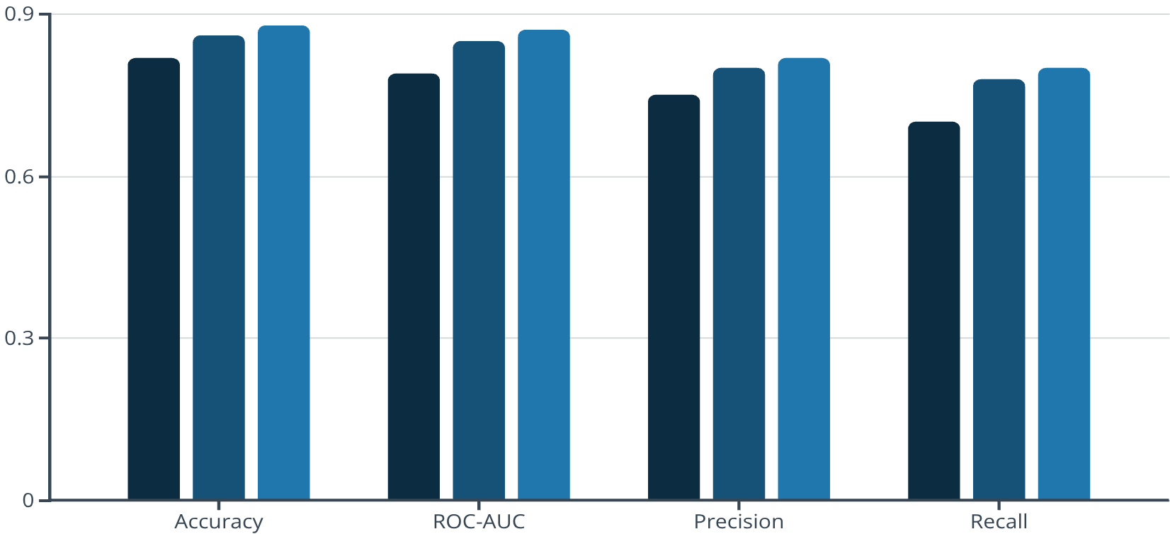
Evaluation Metrics and Key Results
Model performance was rigorously evaluated using industry-standard metrics to ensure reliability and clinical utility:
Accuracy: Overall correctness of predictions.
ROC-AUC: Ability to distinguish between high and low-risk patients.
Precision & Recall: Measuring the model's ability to avoid false positives and false negatives, respectively.
Logistic Regression
Random Forest
XGBoost
The XGBoost model consistently outperformed others across all metrics, indicating its superior ability to predict readmission risk.

Slide 8
Intervention Plan for High-Risk Patients
Based on the model's predictions, a multi-faceted intervention plan will be implemented to support high-risk patients:
Personalised Discharge Planning
Home Healthcare Support
Tailored post-discharge care plans, including follow-up appointments and medication reconciliation.
Referrals to home healthcare services for ongoing monitoring and assistance with daily living.
Telehealth Monitoring
Patient and Family Education
Remote monitoring of vital signs and symptoms, allowing for early detection of complications.
Empowering patients and caregivers with knowledge about managing chronic conditions and recognising warning signs.

